Slide 1


Payment reminder application
Deeksha sahu (229024)
Nikhil solankhi(229046)

Slide 2
AGENDA OF THIS DOCUMENTS IS :
Introduction
Objective
UML Diagrams
Screenshots
Specifications
Requirement
Advantages
Disadvantages
Conclusion
Future Enhancement
References

Slide 3
INTRODUCTION
Payment reminder application is a type of time management computer application that is designed to alert the user and their client of important events in our case the due payment that have been input in our program. This programs provide a list view of events (view ,add ,update), as well as a reminding technique. In this application the reminders are provided through email to the owner of the properties and their clients.

Slide 4
OBJECTIVE
Payment reminder app is useful for those who often forget to pay their rent and for those who find it hard to collect the payment from their clients/tenants. This app reminds them to pay as in case of the tenant and to collect in case of the owner of the properties by sending notifications on email as well as mobile phone. This application makes it very easy to manage the finances and dues.

Slide 5
Technology Used
BACK END → JAVA SPRING BOOT REST API
FRONT END → REACT

Slide 6
UML DIAGRAMS

Slide 7
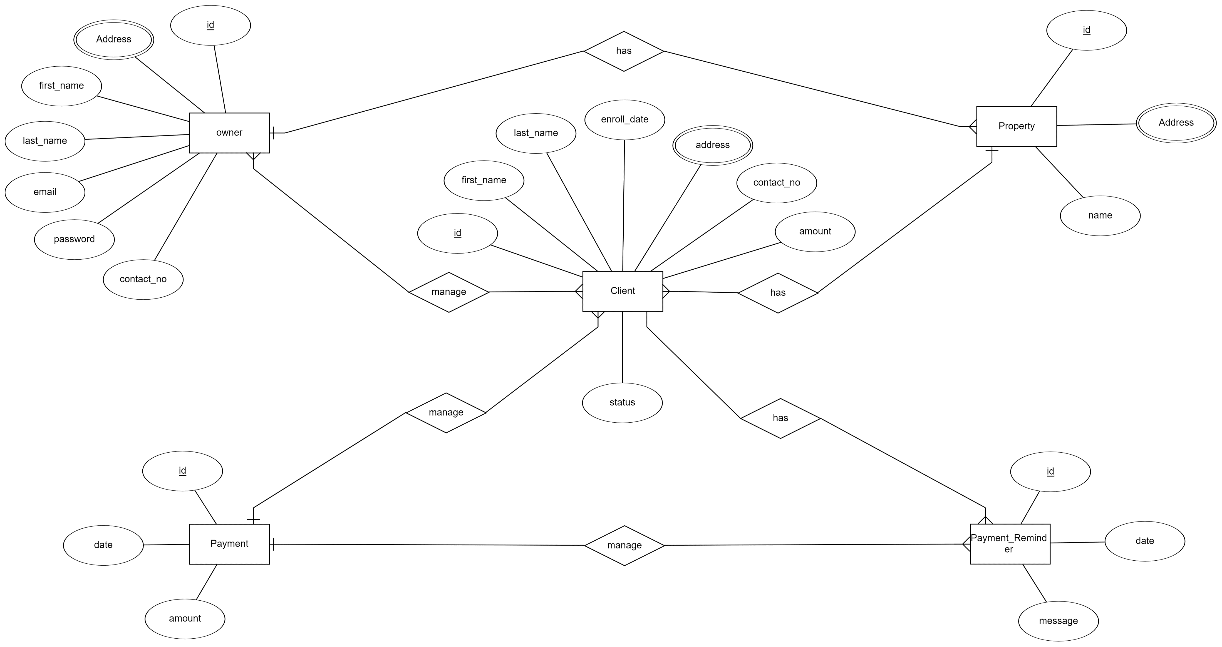
ER DIAGRAM

Slide 8
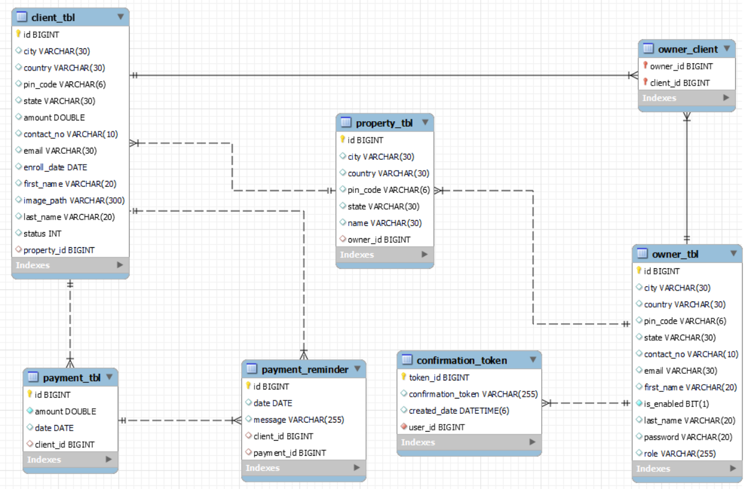
ER DIAGRAM MY SQL AUTO-GENERATED

Slide 9
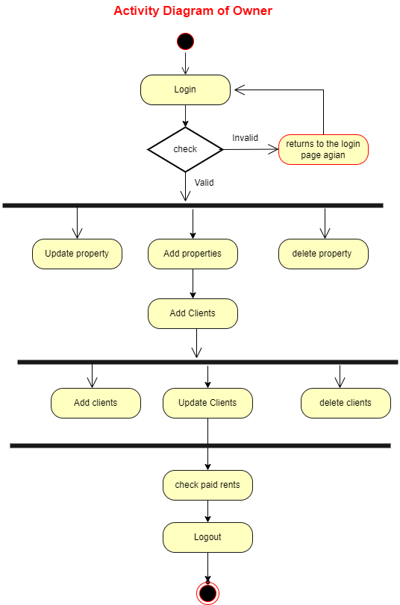
ACTIVITY DIAGRAM OF OWNER

Slide 10
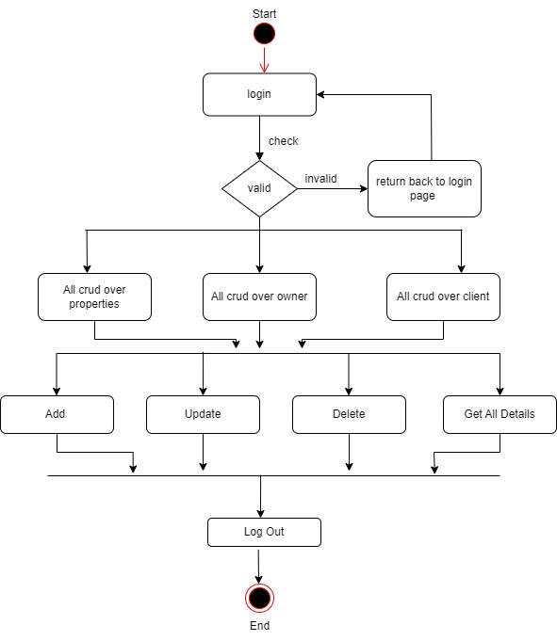
ACTIVITY DIAGRAM OF ADMIN

Slide 11
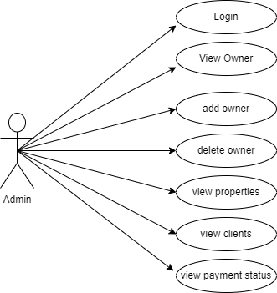
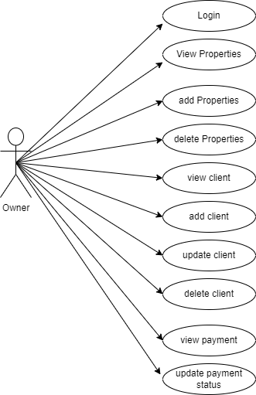
USE CASE DIAGRAM
Admin Use case Diagram
Owner Use case Diagram

Slide 12
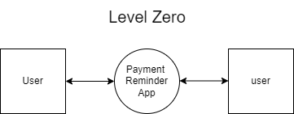
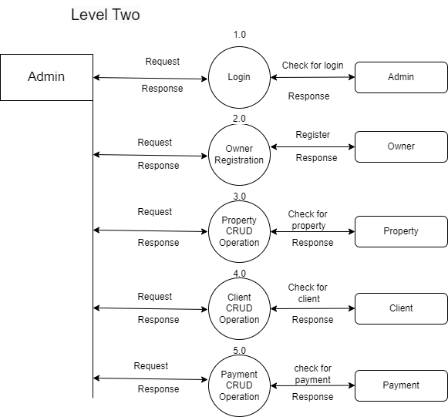
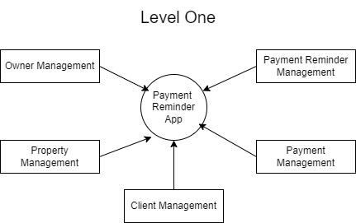
DFD DIAGRAM ADMIN

Slide 13
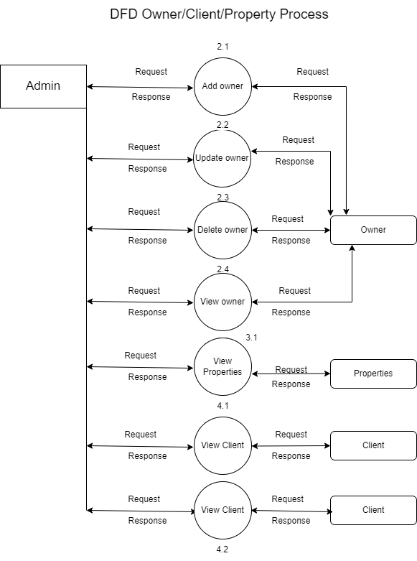
DFD OWNER/PROPERTY/CLIENT PROCESS

Slide 14
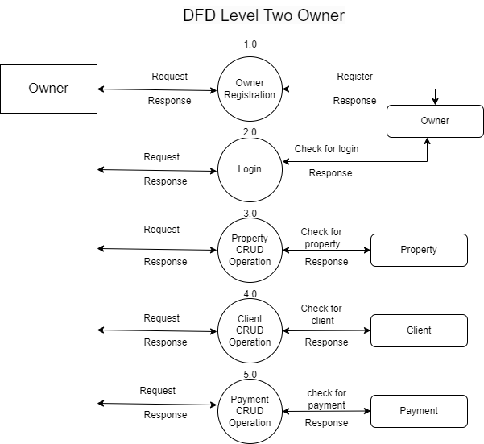
DFD DIAGRAM OWNER

Slide 15
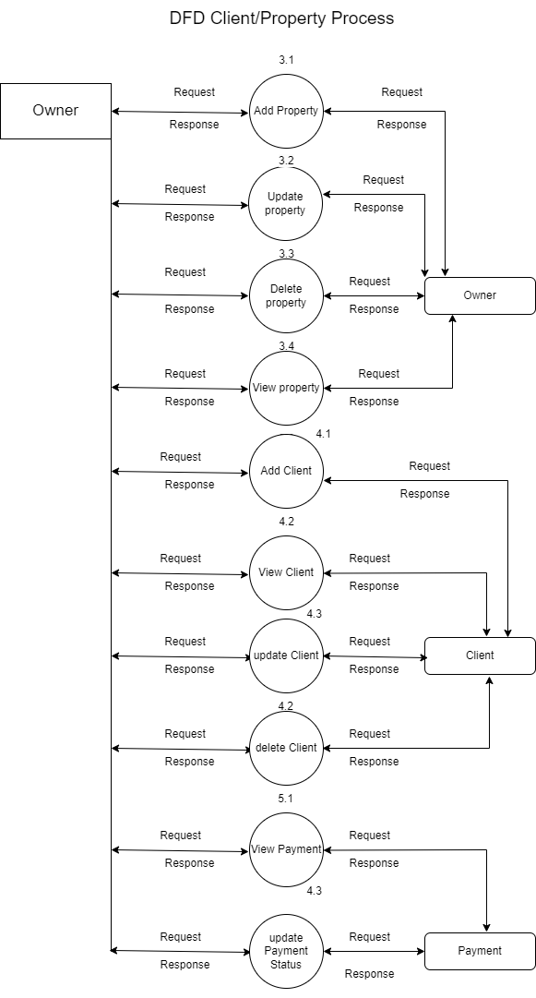
DFD PROPERTY/CLIENT PROCESS

Slide 16
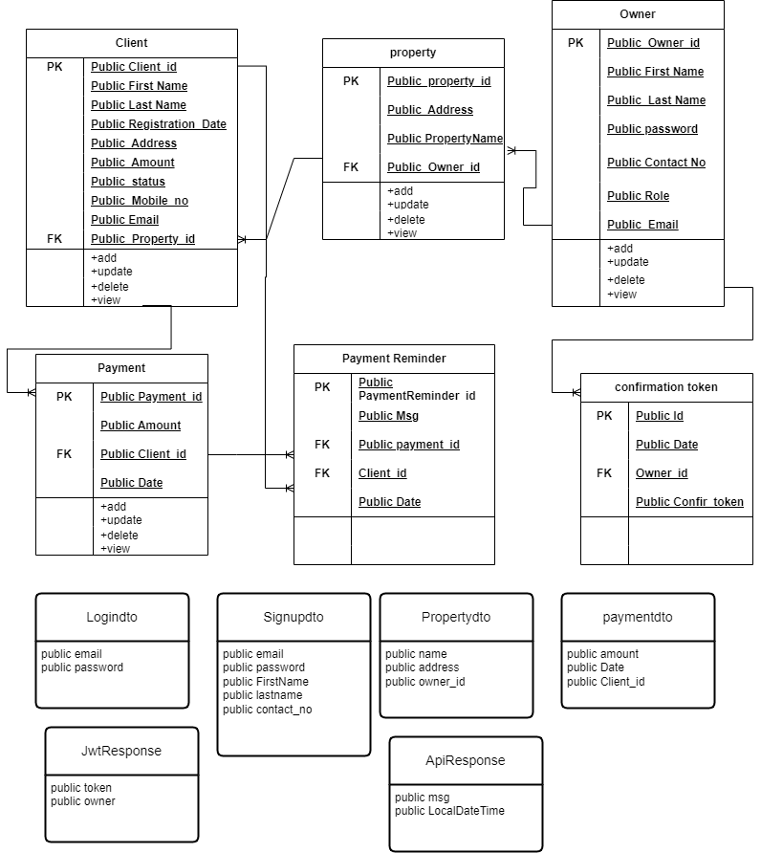
CLASS DIAGRAM

Slide 17
SCREEN SHOTS

Slide 18
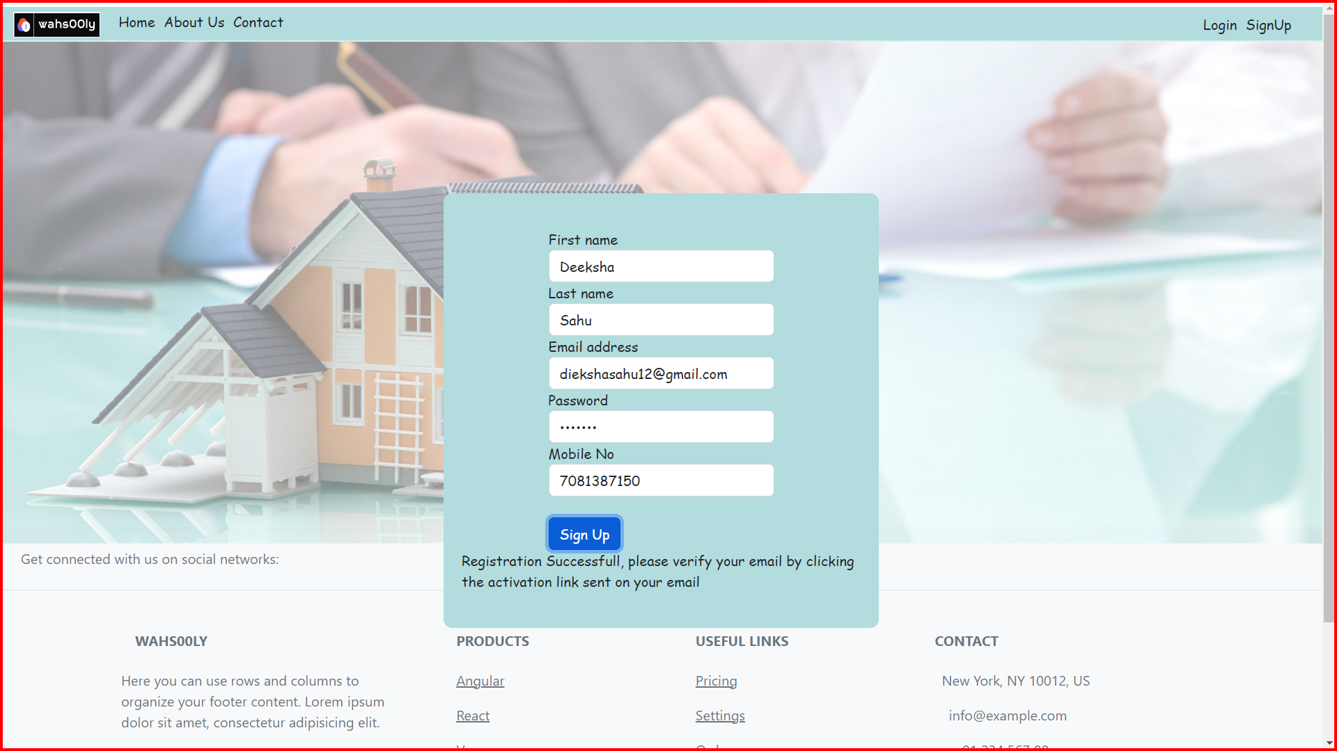

Slide 19
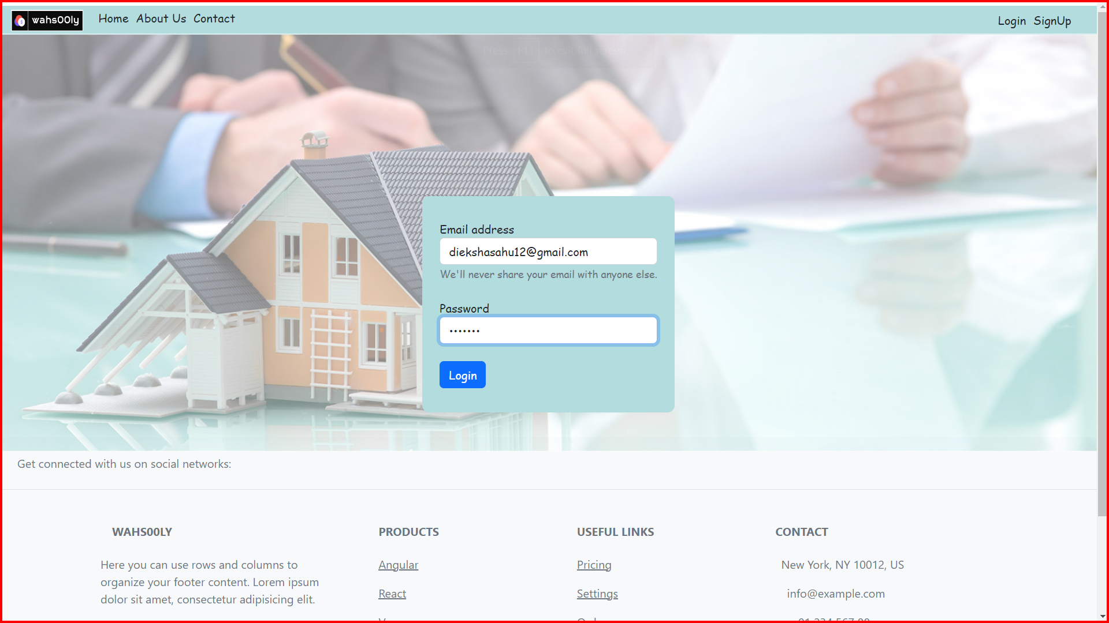

Slide 20
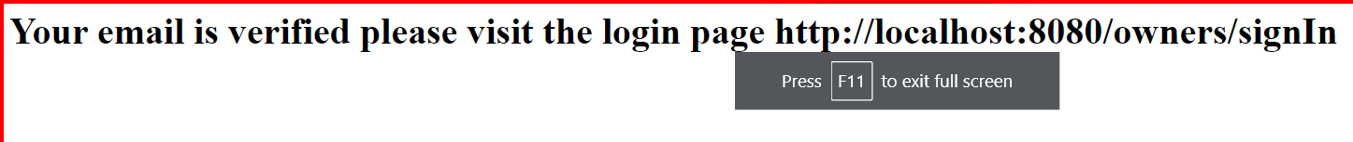

Slide 21
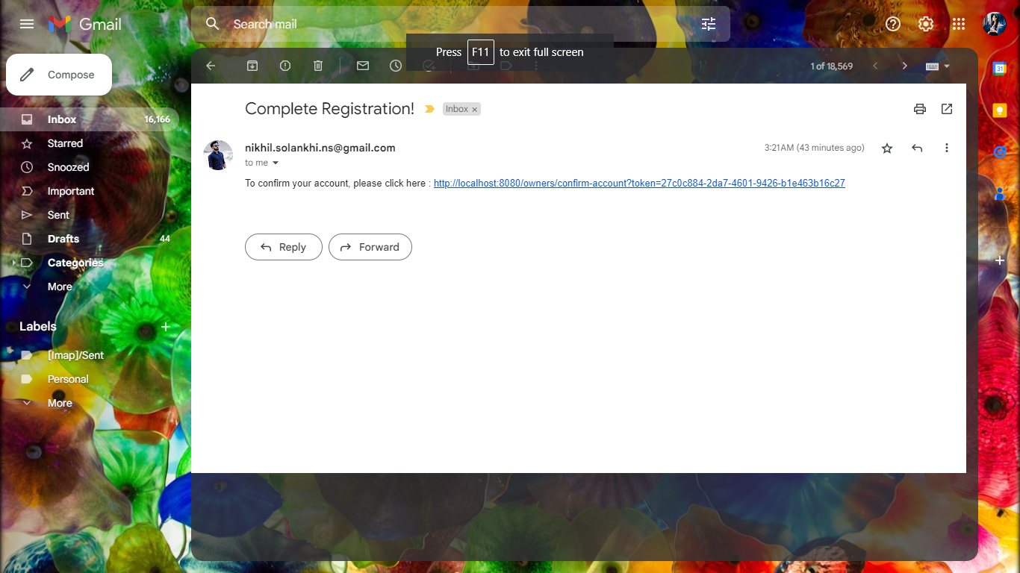

Slide 22
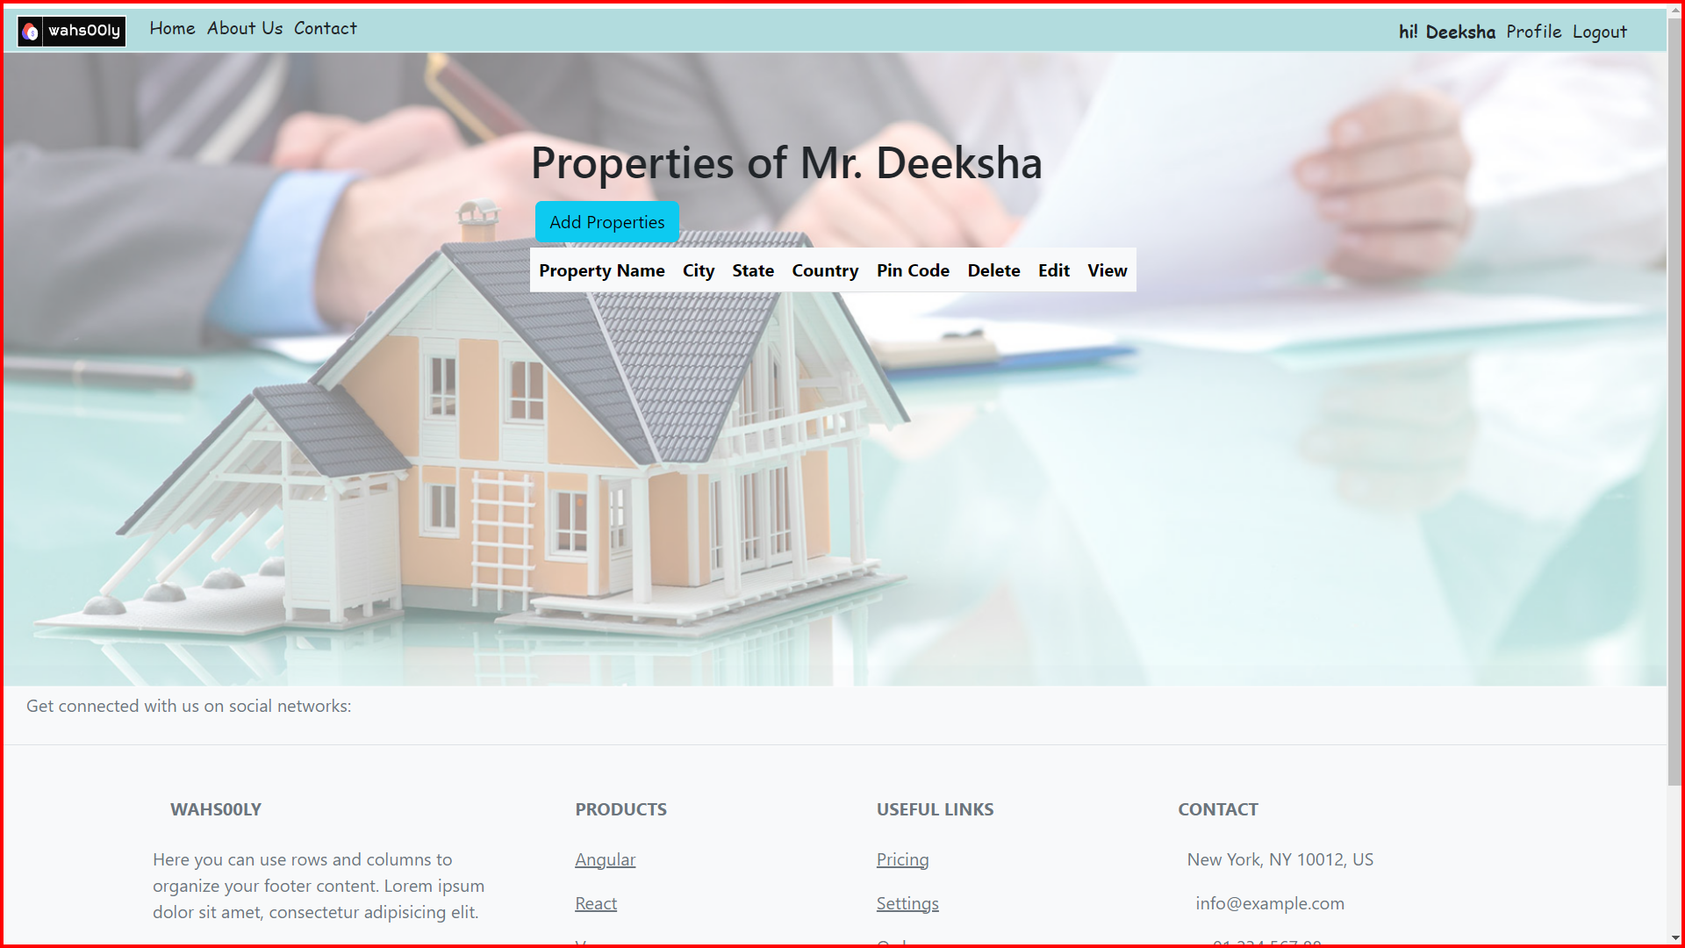

Slide 23
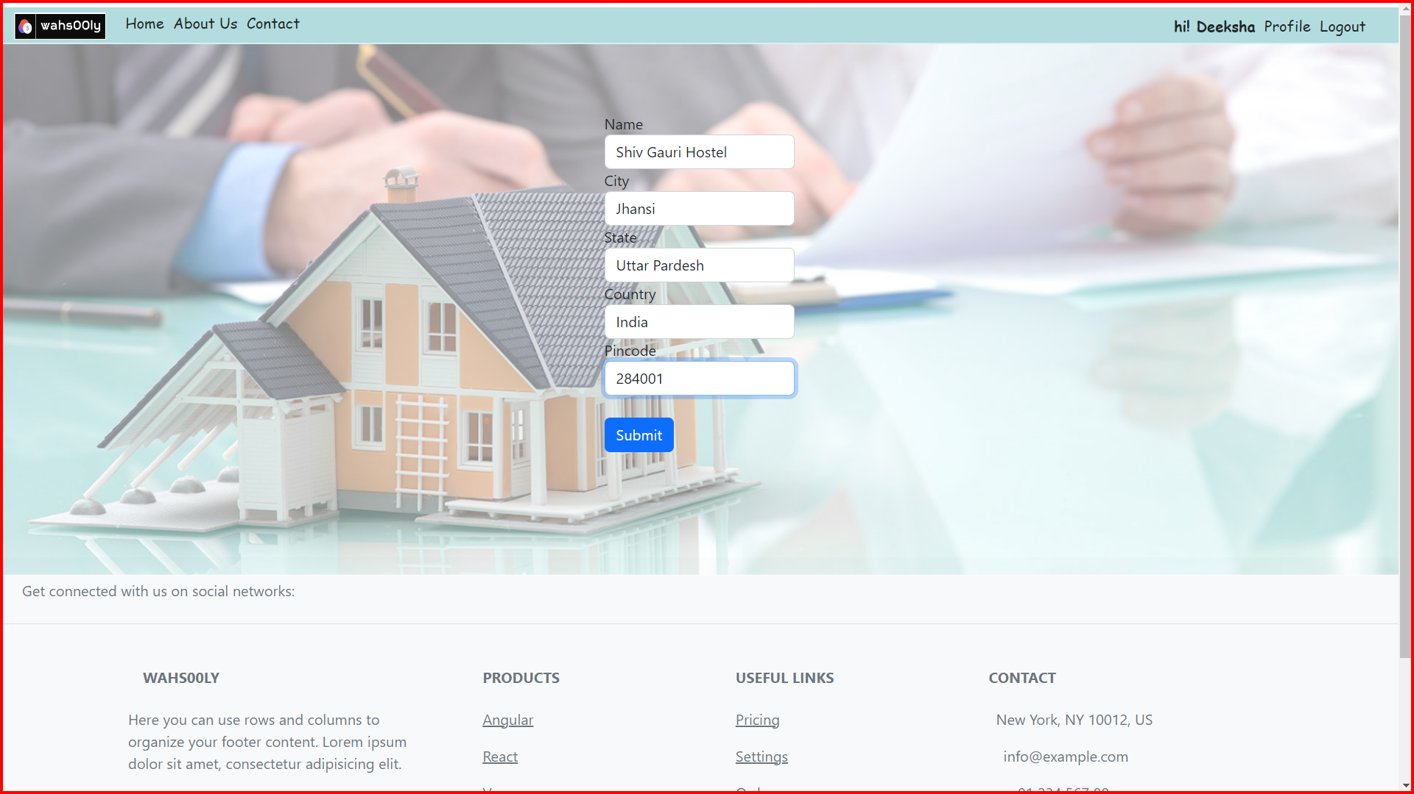

Slide 24
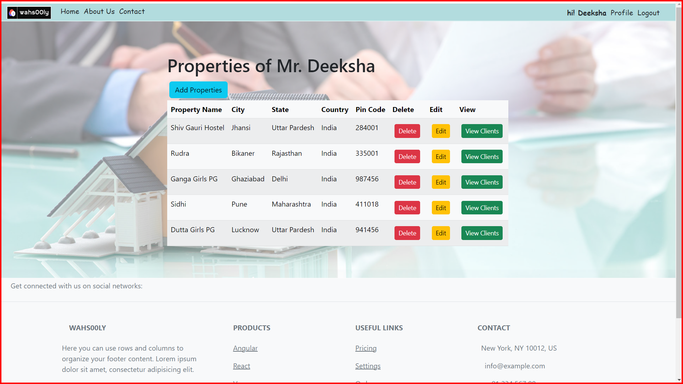

Slide 25
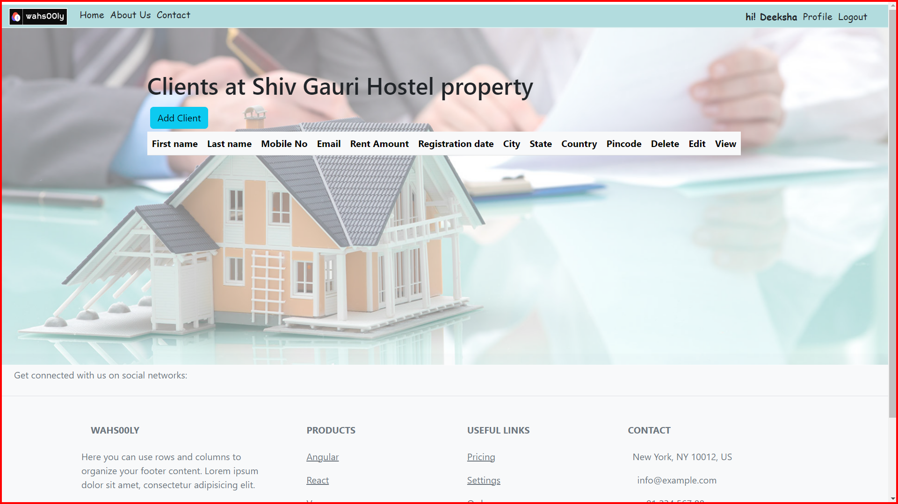

Slide 26
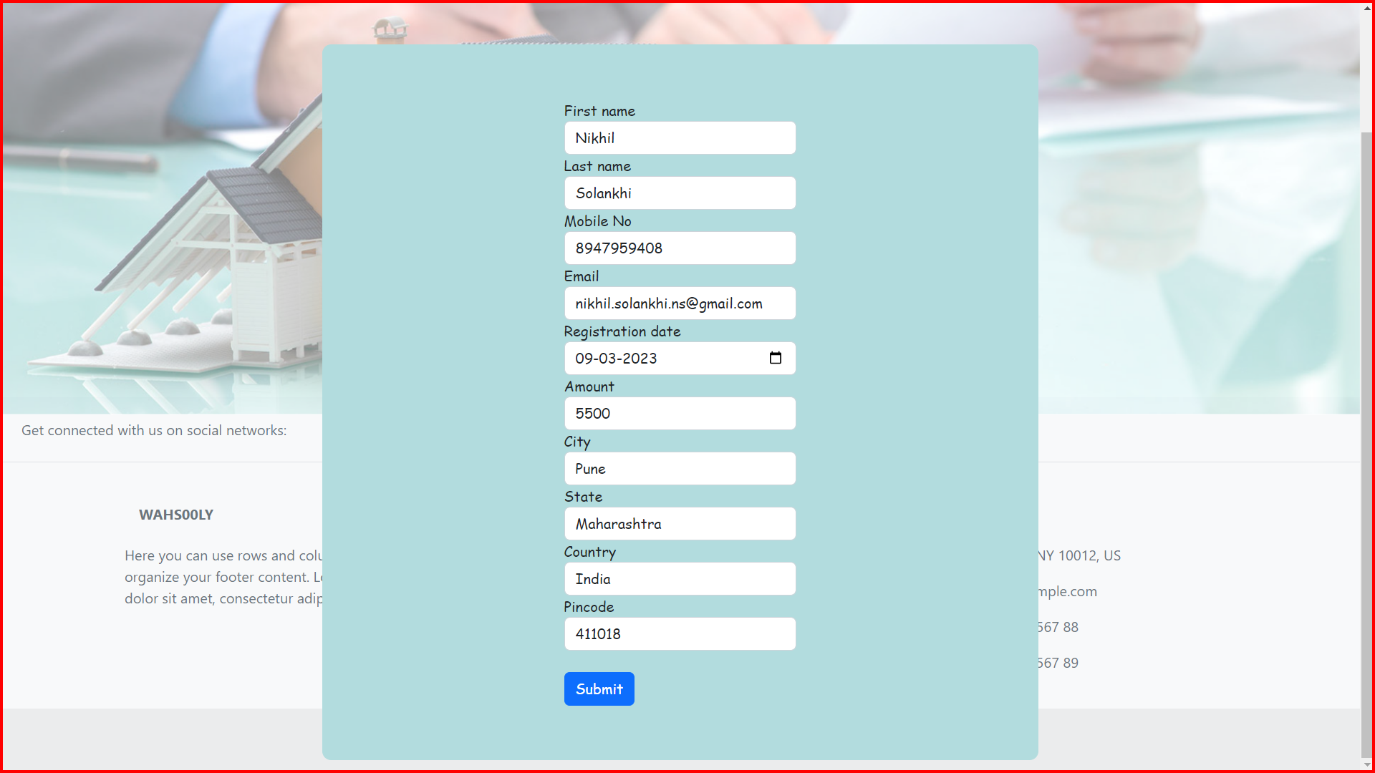

Slide 27
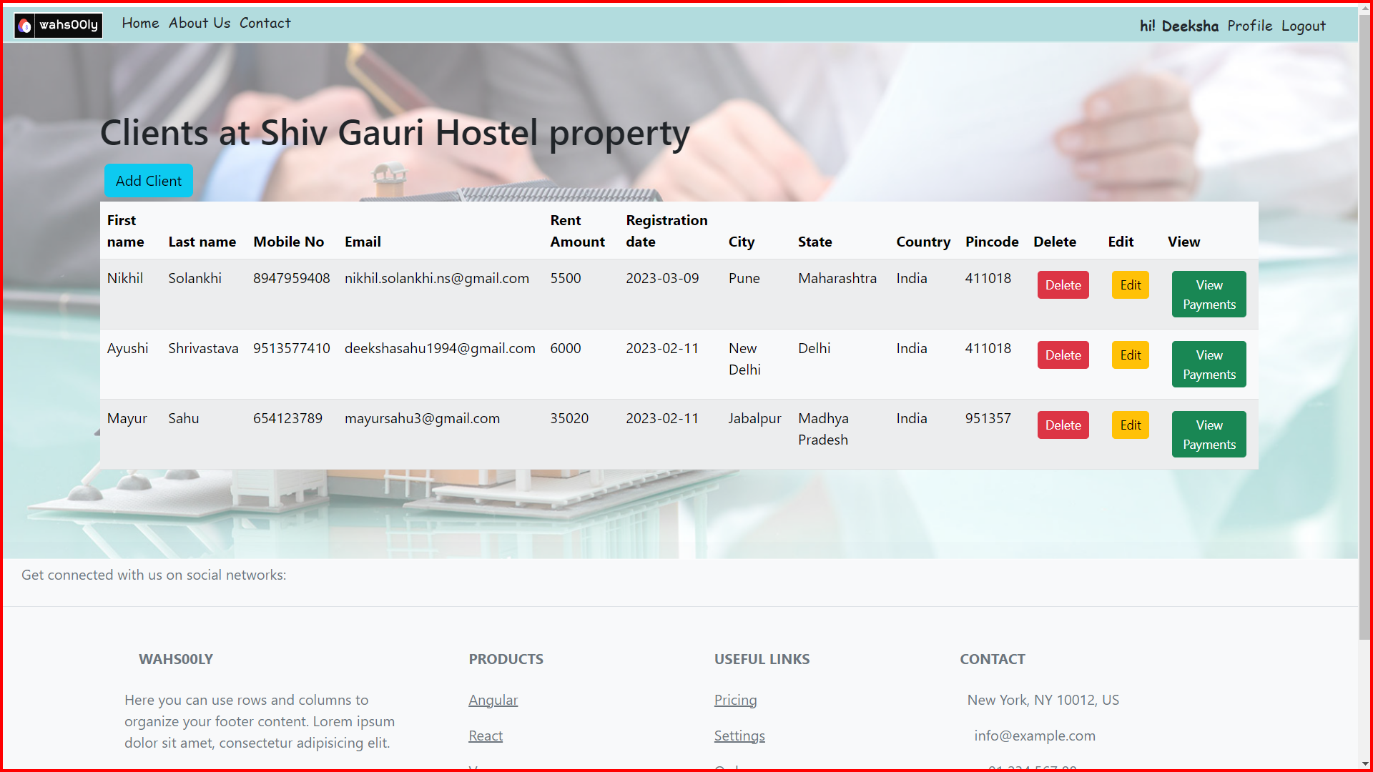

Slide 28
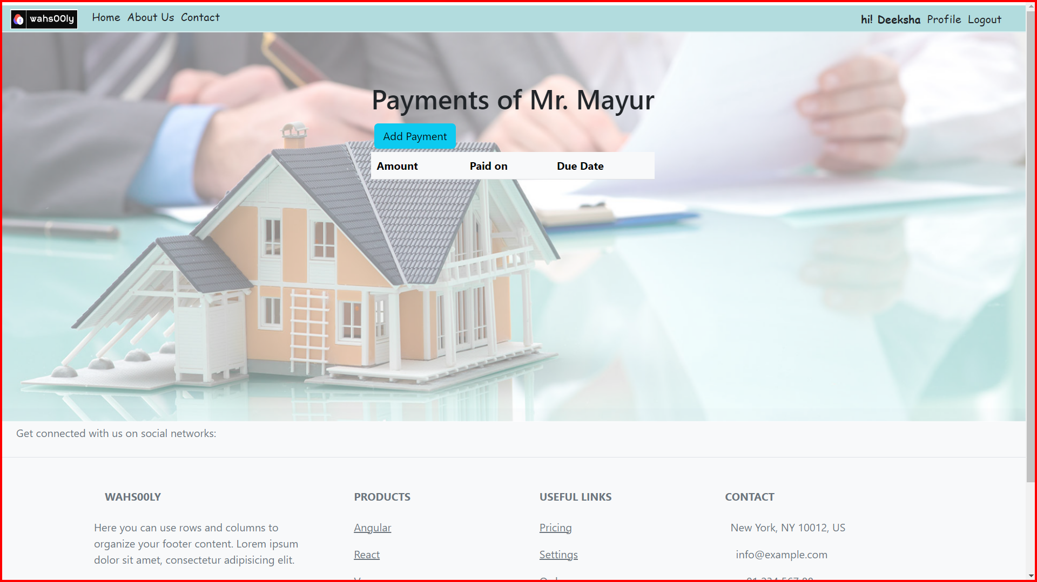

Slide 29
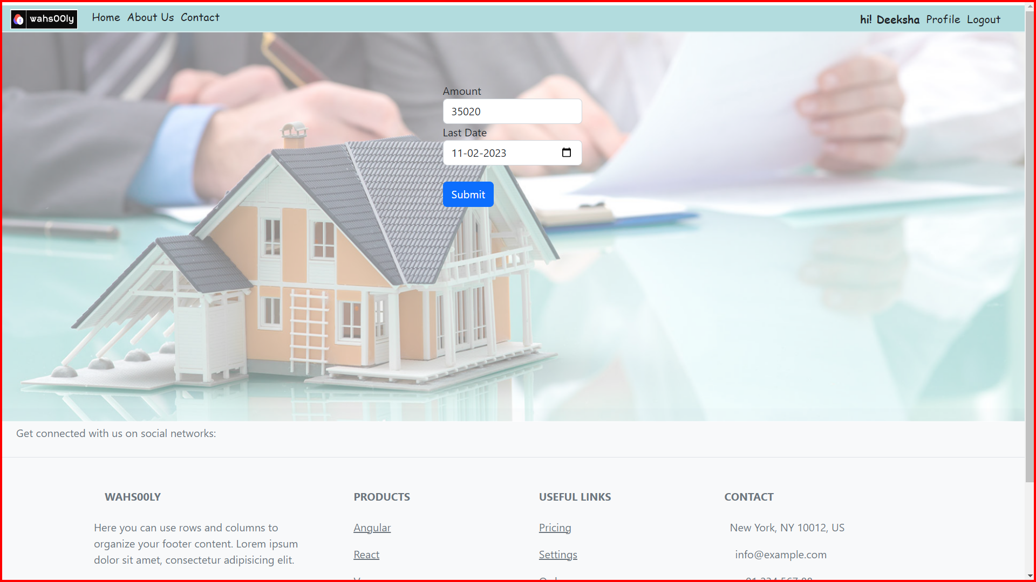

Slide 30
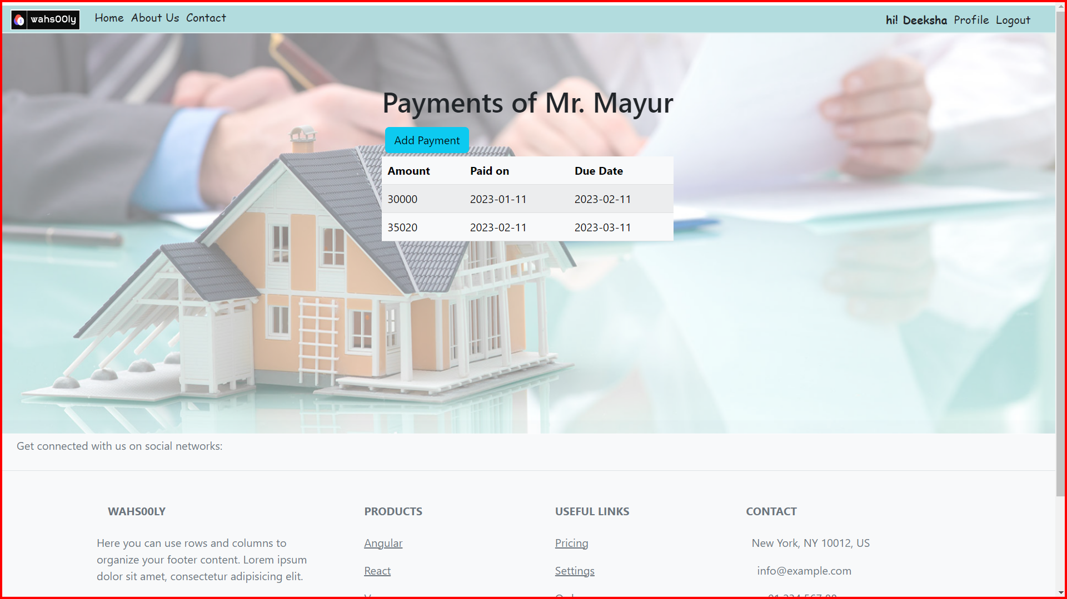

Slide 31
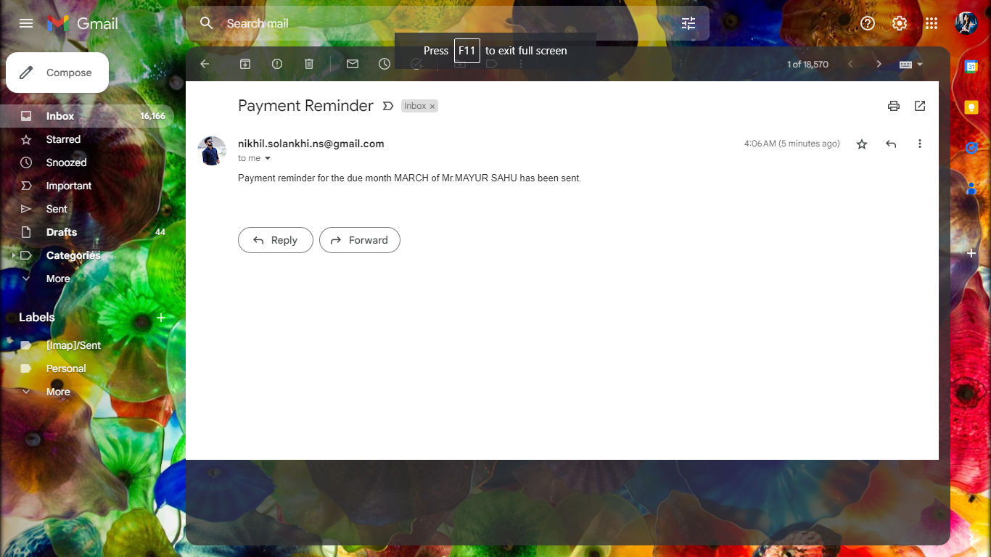

Slide 32
SPECIFICATIONS
The application will use JavaScript, HTML and CSS as main web technologies.
HTTP and FTP protocols are used as communication protocols. FTP is used to upload the web application in live domain and the client can access it via HTTP protocol.
SMTP protocol is used for Email communication.
Several types of validations make this web application secure.
JWT is also used to secure the APIs.
Since PAYMENT REMINDER APP is a web-based application, internet connection must be established.
The PAYMENT REMINDER APP will be used on PCs and will function via internet or intranet in any web browser.

Slide 33
S/W and H/W Requirements
Server Side:
Processor: Intel® Xeon® processor 3500 series
HDD: Minimum 500GB Disk Space
RAM: Minimum 4GB
OS: Windows 10, Linux 6
Database: MySQL
Client Side (minimum requirement):
Processor: Intel Dual Core
HDD: Minimum 80GB Disk Space
RAM: Minimum 2GB
OS: Windows 7, Linux

Slide 34
Advantages
Reach clients through their preferred communication channel for example email.
Provide added security.
Reduce friction in the payment process.
Increased Speed of the operations.
Automated payment reminders are much simpler and faster to process. They can be easily scheduled to arrive in a fixed number of days before or after the due date.
Automated messages allow customers the freedom to open their messages on the move, while also giving them the ability to quickly access the communication at their fingertips rather than searching for a filed-away letter.

Slide 35
Disadvantages
Learning curve: Learning how to use a PRA rental application can take time, especially for those who are not familiar with technology. It may require training for staff or additional time for landlords to learn how to use the application effectively.
Dependence on technology: As with any technology, there is always a risk of system downtime, technical glitches, or cyber threats. If the PRA rental application goes down or experiences technical issues, it can disrupt the management of rental properties.
Limited customization: Some PRA rental applications may have limited customization options, meaning that landlords or property managers may not be able to customize the application to their specific needs.

Slide 36
Conclusion
In conclusion, a PRA (Property Rental Application) can provide a comprehensive software solution for property managers and landlords to manage their rental properties more efficiently. By automating tasks, improving communication, and increasing efficiency, a PRA rental application can help landlords and property managers save time and effort, while also enhancing the rental experience for tenants.
Overall, a PRA rental application can be an excellent investment for landlords and property managers who want to streamline their property management tasks, improve communication, and enhance the rental experience for tenants. It is crucial to choose a reputable PRA rental application provider that offers robust security measures, excellent customer support, and a user-friendly interface to ensure the best possible experience.

Slide 37
Future Enhancement
Mobile app: Creating a mobile app version of the PRA rental application would allow landlords and property managers to manage their properties and communicate with tenants while on the go.
Analytics and reporting: Adding analytics and reporting functionality to the PRA rental application could provide landlords and property managers with valuable insights into their rental properties' performance, including occupancy rates, revenue, and expenses.
Virtual reality tours: Incorporating virtual reality tours into the PRA rental application could provide prospective tenants with a more immersive rental property viewing experience.
Language translation: Providing language translation services within the PRA rental application could make it easier for landlords and property managers to communicate with tenants who speak different languages.

Slide 38
References
JavaScript Enlightenment, Cody Lindley-First Edition, based on JavaScript 1.5, ECMA-262, Edition
Mc Graw Hill’s, Java: The complete reference 7thEdition, HerbertScheldt
Complete CSS Guide, Maxine Sherrin and John Allsopp- O'ReillyMedia; September 2012
ONLINE REFERENCE
www.Google.com
www.w3school.com
www.javatpoint.co

